Slide 1

Parallel Implementation of the Bilateral Filter in Python
ME 574 Final Project
June 10, 2021
Albert Wang

Slide 2
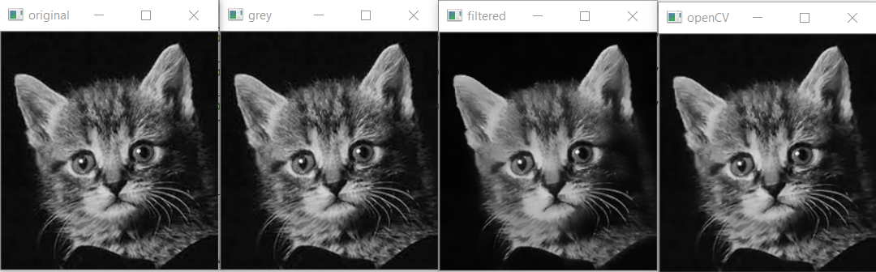
Overview
The bilateral filter is an image processing tool with many uses, and primarily implemented to denoise image while retaining edge sharpness
Uses spatial-based Gaussian blur combined with intensity gradients
Applications in computational photography
Denoising
Tone mapping
Relighting / texture editing
Implementation inspiration from NPP & CUDA Sample Docs

Slide 3
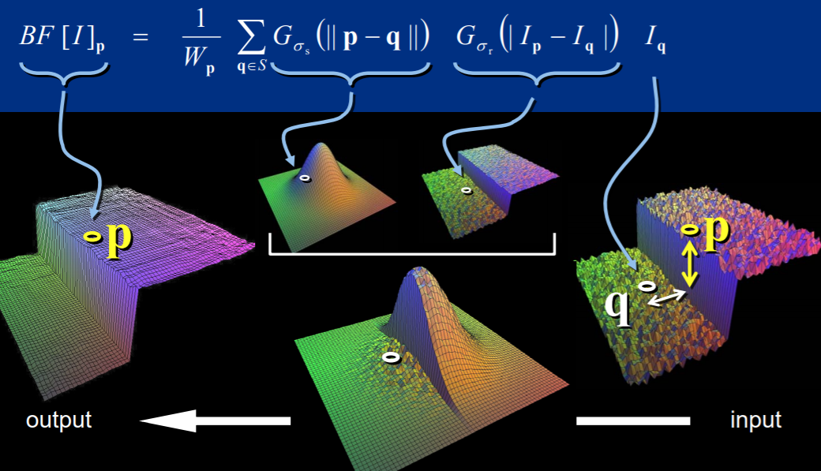

Slide 4
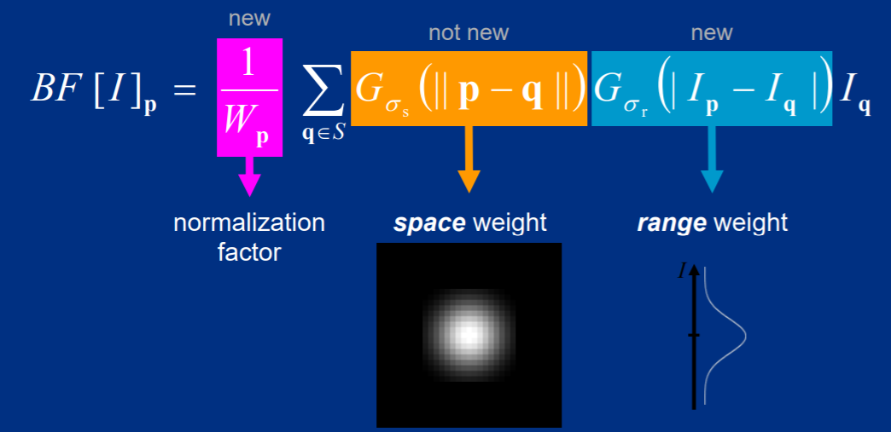

Slide 5
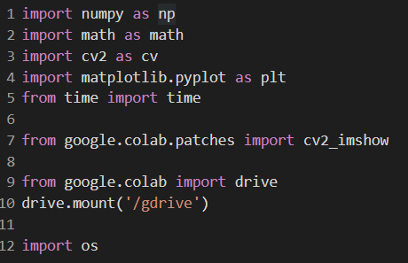
Code Setup

Slide 6
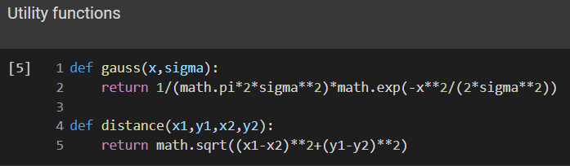
Code Setup

Slide 7
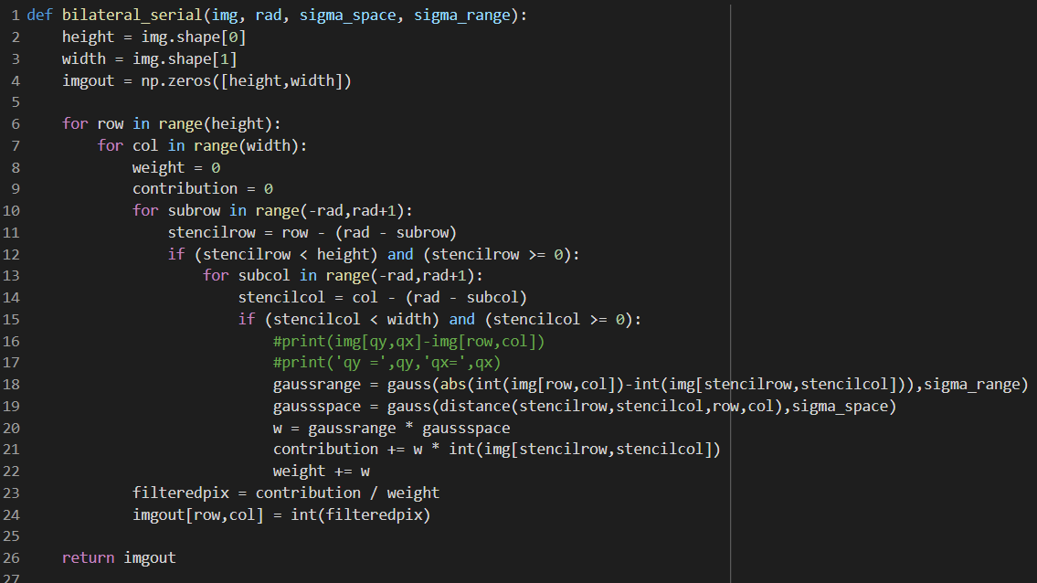
Serial Implementation
Notes:
In the serial implementation we run a doubly nested for loop
At the top level we iterate over every pixel p in the image
At the lower level we then iterate over every pixel q in the stencil centered around pixel p
We ensure that the neighboring pixels are within the stencil and image bounds, and are able to calculate the contributions of the difference between pixels q and p in terms of space and range
We then use the previous equation and output the filtered version of the image

Slide 8
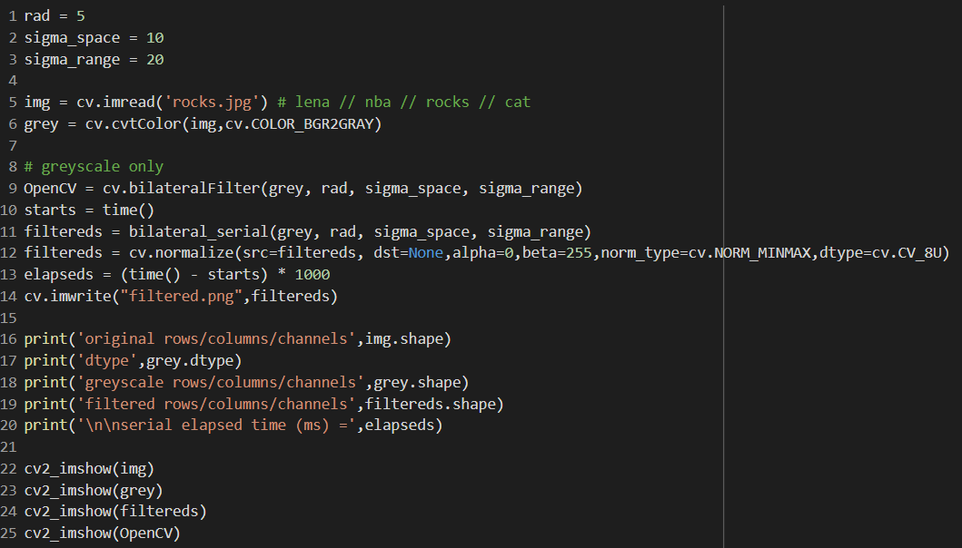
Serial Implementation

Slide 9
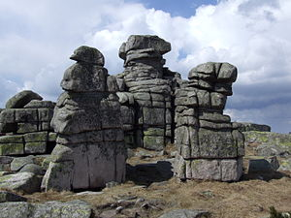

Slide 10
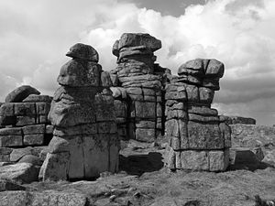

Slide 11


Slide 12


Slide 13
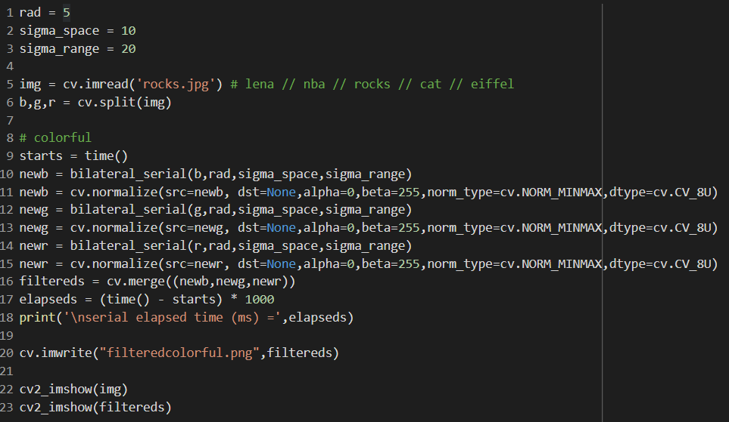
Serial Implementation

Slide 15
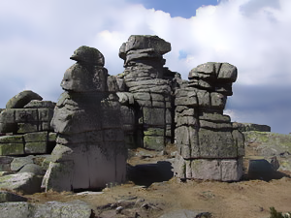

Slide 16
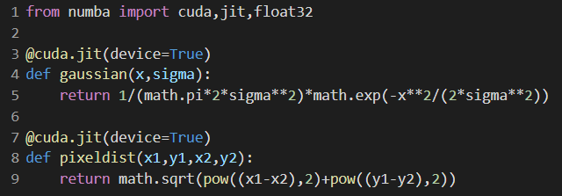
Parallel Implementation

Slide 17
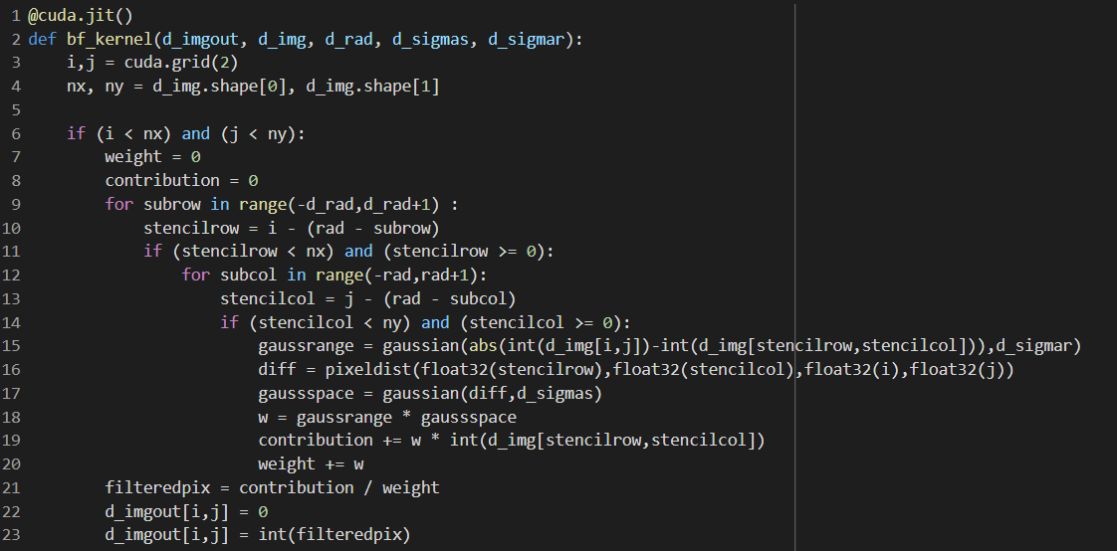
Parallel Implementation
Notes:
In this parallelized kernel, we task each individual thread with filtering each pixel p
The stencil calculations for each q pixel are still serialized within a single thread
For a 500*500 pixel image and a 10*10 stencil, the computational efficiency comes from running 250000 pixels simultaneously while each thread runs 100 stencil pixels in series

Slide 18
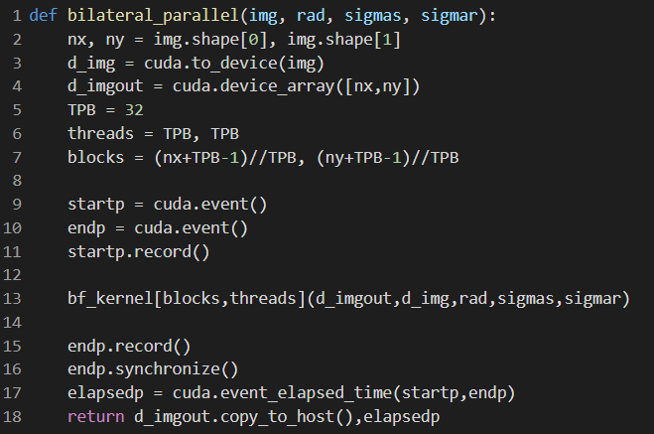
Parallel Implementation
Notes:
The bulk of the calculations are the same as in series
In the parallel filter wrapper, we define the standard parameters and time the execution time using cuda events

Slide 19
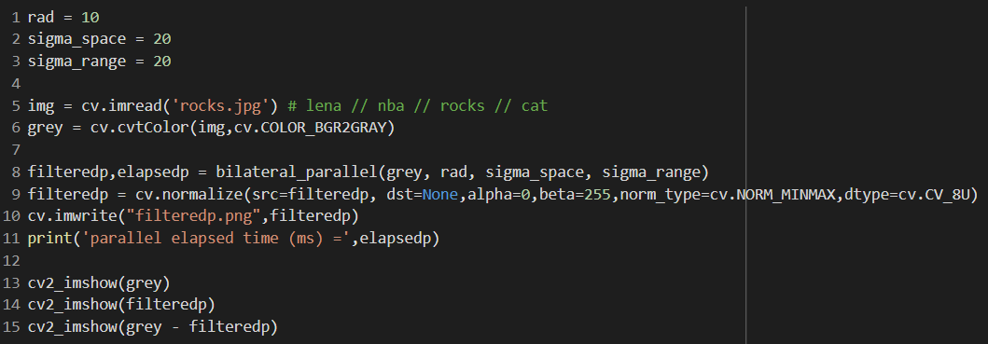
Parallel Implementation

Slide 21


Slide 22
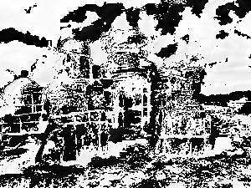

Slide 23
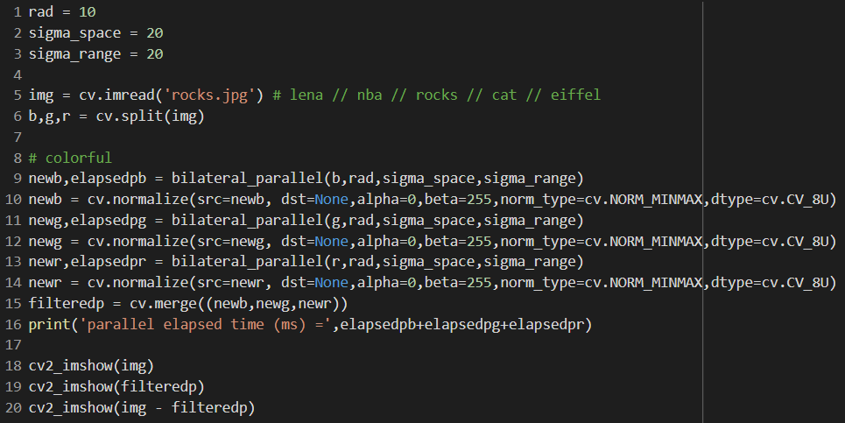
Parallel Implementation

Slide 25
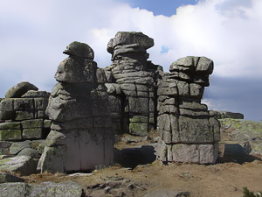

Slide 26


Slide 27
Timing
 |  | Greyscale | Color RGB
Serial (ms) |  | 32938.40503692627 | 97216.7775630951
Parallel (ms) | Initial | 997.8004150390625 | 68.26412963867188
 | compiled | 22.5447998046875 | 70.66598510742188
Speedup |  | x1461 | x1376

Slide 28
Future Improvements
Parallel efficiency
Current implementation using global memory
Shared memory would improve code efficiency for stencil computations
Color
Current implementation for single color values images only
Greyscale – base intensity
Color – filter one color then merge multiple filtered results
Adjustments required to handle “intensity” differences as RGB vector instead of scalar values
Single vector calculation could increase code efficiency

Slide 29
References
http://people.csail.mit.edu/sparis/bf_course/
http://people.csail.mit.edu/sparis/bf_course/slides/03_definition_bf.pdf
http://people.csail.mit.edu/sparis/bf_course/course_notes.pdf
https://en.wikipedia.org/wiki/Bilateral_filter
https://docs.nvidia.com/cuda/cuda-samples/index.html#bilateral-filter
https://docs.nvidia.com/cuda/pdf/CUDA_Samples.pdf

